Slide 1
Bitbucket
An introduction of Bitbucket and its usages
J S Jodha

Slide 2
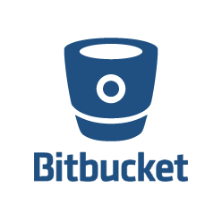
Introduction
BitBucket is a web-based code server and also a great management tool for software projects.
Bitbucket is a hosting service for projects that use either the Mercurial or Git revision control systems. Bitbucket offers free source code hosting for Git and Mercurial projects as well as project wikis and issue tracking. Host your code online in as many public and private repositories as you want. Free five-user tier accounts! Manage your projects with confidence with builtin issue trackers, wikis, code comments, and pull requests. Bitbucket is written in Python using the Django web framework. It is similar to GitHub, which primarily uses Git

Slide 3
SCM System
It’s a way that we use to store projects’ source code files in a tree of versions.
With no deal, all those SCMs creators build them on the same rules and structure.
A lot of popular open source projects source codes are collected together all over the world using SCM systems.

Slide 4
SCM Operations
We can sort operations that we can do with any SCMS into 4 main categories:
▪ Bootstrap (init, checkout, switch branch)
▪ Modify (add, delete, rename, commit)
▪ Information (status, diff, log)
▪ Reference (tag, branch)

Slide 5
Why Host codes online???
Any programmer worth their salt knows that source control is crucial. The most obvious perk is allowing you to securely store your code in a safe place. It doesn’t stop there. Having good source control makes it easier to experiment with new features without worrying about irreparably damaging your program. Source control is something we all should do.
Sample Hosting services include:
SourceForge
Google Code
GitHub
BitBucket

Slide 6
The need of online collaborative work.
Track your change sets, monitor your source code edits, and drill through to your source files.
It’s worth having a backup.
The quicker you make your code publicly available, the quicker you can gain feedback and people to help you.
Getting feedback of users and interested developers who might want to join your team, provide helpful idea and move this project forward

Slide 7
Git under Bitbucket
Git is an open source program for tracking changes in text files
Decentralized or Distributed Source Code Management(SCMS).
Superior branching and merging mechanism.
Support various protection devices against corruption.
Supported by various code servers.

Slide 8
Technical Terms
Repository : It refers to a storage location, often for safety or preservation. A repository contains all of the project files (including documentation), and stores each file's revision history. Repositories can have multiple collaborators and can be either public or private.
Fork : A fork is a personal copy of another user's repository that lives on your account. Forks allow you to freely make changes to a project without affecting the original. Forks remain attached to the original, allowing you to submit a pull request to the original's author to update with your changes
Clone: A clone is a copy of a repository that lives on your computer instead of on a website's server somewhere, or the act of making that copy. With your clone you can edit the files in your preferred editor and use Git to keep track of your changes without having to be online.

Slide 9
Technical Terms
Pull: Pull refers to when you are fetching in changes and merging them. For instance, if someone has edited the remote file you're both working on, you'll want to pull in those changes to your local copy so that it's up to date.
Commit: A commit, or "revision", is an individual change to a file (or set of files). It's like when you save a file, except with Git, every time you save it creates a unique ID (a.k.a. the "SHA" or "hash") that allows you to keep record of what changes were made when and by who. Commits usually contain a commit message which is a brief description of what changes were made.
Push: Pushing refers to sending your committed changes to a remote repository such as Bitbucket. For instance, if you change something locally, you'd want to then push those changes so that others may access them
Fetch: Fetching refers to getting the latest changes from an online repository (like BitBucket) without merging them in. Once these changes are fetched you can compare them to your local branches (the code residing on your local machine)

Slide 10
Branching and Merging
Frictionless Context Switching. Create a branch to try out an idea, commit a few times, switch back to where you branched from, apply a patch, switch back to where you are experimenting, and merge it in.
Role-Based Codelines. Have a branch that always contains only what goes to production, another that you merge work into for testing, and several smaller ones for day to day work.
Feature Based Workflow. Create new branches for each new feature you're working on so you can seamlessly switch back and forth between them, then delete each branch when that feature gets merged into your main line.
Disposable Experimentation. Create a branch to experiment in, realize it's not going to work, and just delete it - abandoning the work—with nobody else ever seeing it (even if you've pushed other branches in the meantime).

Slide 11
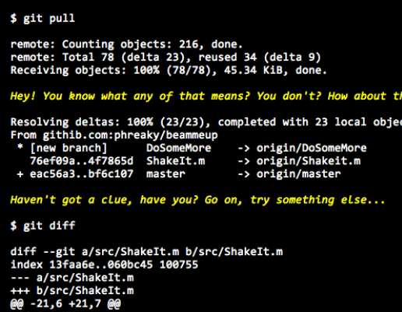
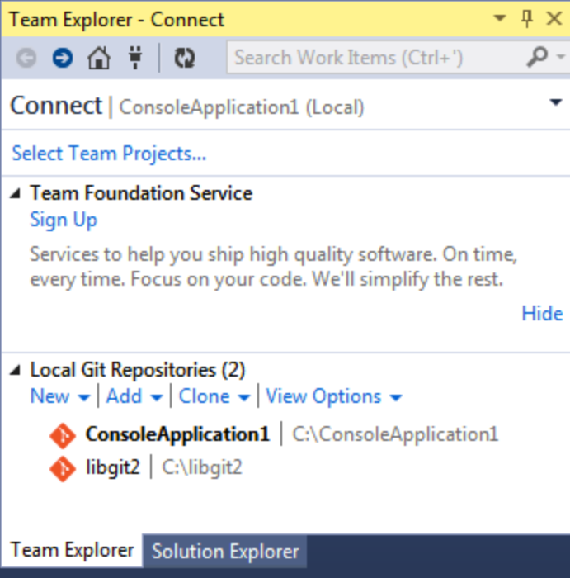
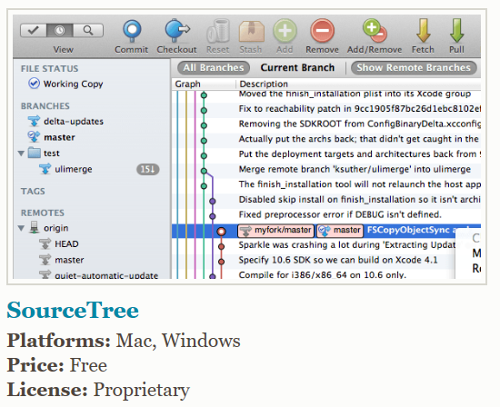
Using Git
Git bash (CLI)
Git in Visual Studio
Source Tree

Slide 12
Refrences
http://progit.org: A good free book for git,
https://git-scm.com/book/en/v2/Getting-Started-Git-Basics:
https://www.sourcetreeapp.com/ (Source Tree)
https://visualstudio.github.com/ (Visual studio extension)
https://www.atlassian.com/git/tutorials/learn-git-with-bitbucket-cloud

Slide 13
Demo Time.

Slide 14
Q & A

